Slide 1




ACT: Architectural Carbon Modeling Tools
@ MICRO 2022
Tutorial
Udit Gupta

Slide 2

ACT Tutorial: Today
Time | Topic
1:00 – 1:15pm | Introductory remarks
1:15 – 1:30pm | Motivation: Understanding the source of computing’s emissions
1:30 – 2:15pm | Overview of ACT: An Architectural Carbon Modeling Tool
2:15 –2:30pm | Coffee Break
2:30 – 3:00pm | Hands-on ACT demo’s
3:00 – 3:15pm | Extending ACT
3:15 – 3:45pm | Office Hours
3:45 – 4:00pm | Closing remarks
Notes:
Finally, given our understanding of carbon emissions, we will conclude by charting paths for how to design future sustainable computing systems.

Slide 3
Today
Where does computing’s carbon footprint come from?
Notes:
Specifically we ask the question, where does computing’s carbon footprint come from?
In our journey to answer this question what we found was quite surprising to some of our collaborators that have spent a lot of time thinking about hardware performance and energy efficiency optimizations.

Slide 4




Today
Where does computing’s carbon footprint come from?
Application
Mobile
Data center
Notes:
In particular we found that computing’s carbon footprint comes not only from energy consumed by running applications on hardware

Slide 5

Today
Where does computing’s carbon footprint come from?
A combination of both energy consumed and hardware manufacturing (embodied carbon).
Application
Mobile
Data center
Notes:
But also from manufacturing hardware devices.

Slide 6
Today
Where does computing’s carbon footprint come from?
A combination of both energy consumed and hardware manufacturing (embodied carbon).
Application
Mobile
Data center
Understanding the breakdown of mobile emissions
Fabs
Notes:
Finally, given our understanding of carbon emissions, we will conclude by charting paths for how to design future sustainable computing systems.

Slide 7
Today
Where does computing’s carbon footprint come from?
A combination of both energy consumed and hardware manufacturing (embodied carbon).
Application
Mobile
Data center
Understanding the breakdown of mobile emissions
Understanding the breakdown of data center emissions
Fabs
Notes:
Finally, given our understanding of carbon emissions, we will conclude by charting paths for how to design future sustainable computing systems.

Slide 8
Today
Where does computing’s carbon footprint come from?
A combination of both energy consumed and hardware manufacturing (embodied carbon).
Application
Mobile
Data center
Understanding the breakdown of mobile emissions
Understanding the breakdown of data center emissions
Understanding the breakdown of semiconductor manufacturing
Fabs
Notes:
Finally, given our understanding of carbon emissions, we will conclude by charting paths for how to design future sustainable computing systems.

Slide 9
Today
Where does computing’s carbon footprint come from?
A combination of both energy consumed and hardware manufacturing (embodied carbon).
Application
Mobile
Data center
Understanding the breakdown of mobile emissions
Understanding the breakdown of data center emissions
Understanding the breakdown of semiconductor manufacturing
Fabs
Notes:
Finally, given our understanding of carbon emissions, we will conclude by charting paths for how to design future sustainable computing systems.

Slide 10
Life Cycle Analysis: key to understanding carbon emissions
Notes:
To study the breakdown of carbon emissions in mobile devices, we will use life cycle analyses or LCAs.
LCAs are frequently used to quantify the emissions across four phases of products.
This includes hardware systems.
The first phase is manufacturing the product, or hardware platform.

Slide 11
Life Cycle Analysis: key to understanding carbon emissions
Notes:
The second is transporting it from fabs to users.

Slide 12
Life Cycle Analysis: key to understanding carbon emissions
Notes:
The third is using the hardware mobile device.

Slide 13
Life Cycle Analysis: key to understanding carbon emissions
Notes:
The final phase is recycling and end of hardware life processing.
Portions of the hardware platforms can be repurposed for future iterations.

Slide 14
Life Cycle Analysis: key to understanding carbon emissions
Energy consumption
Focus of systems, software, and hardware designers
“Operational”
Notes:
When considering the carbon footprint of computing systems, systems, software, and hardware designers typically focus on product use or energy consumption.

Slide 15
Life Cycle Analysis: key to understanding carbon emissions
Hardware manufacturing
Energy consumption
Emissions from fabs building chips
Focus of systems, software, and hardware designers
Overheads from infrastructure related activities
“Embodied”
“Operational”
Notes:
However, through our analysis we find that for many use cases hardware manufacturing also contributes a significant portion of emissions to the overall hardware life cycle.
Where emissions from hardware use can be seen as opex-related emissions, we can think of emissions from manufacturing as capex-related footprint.

Slide 16
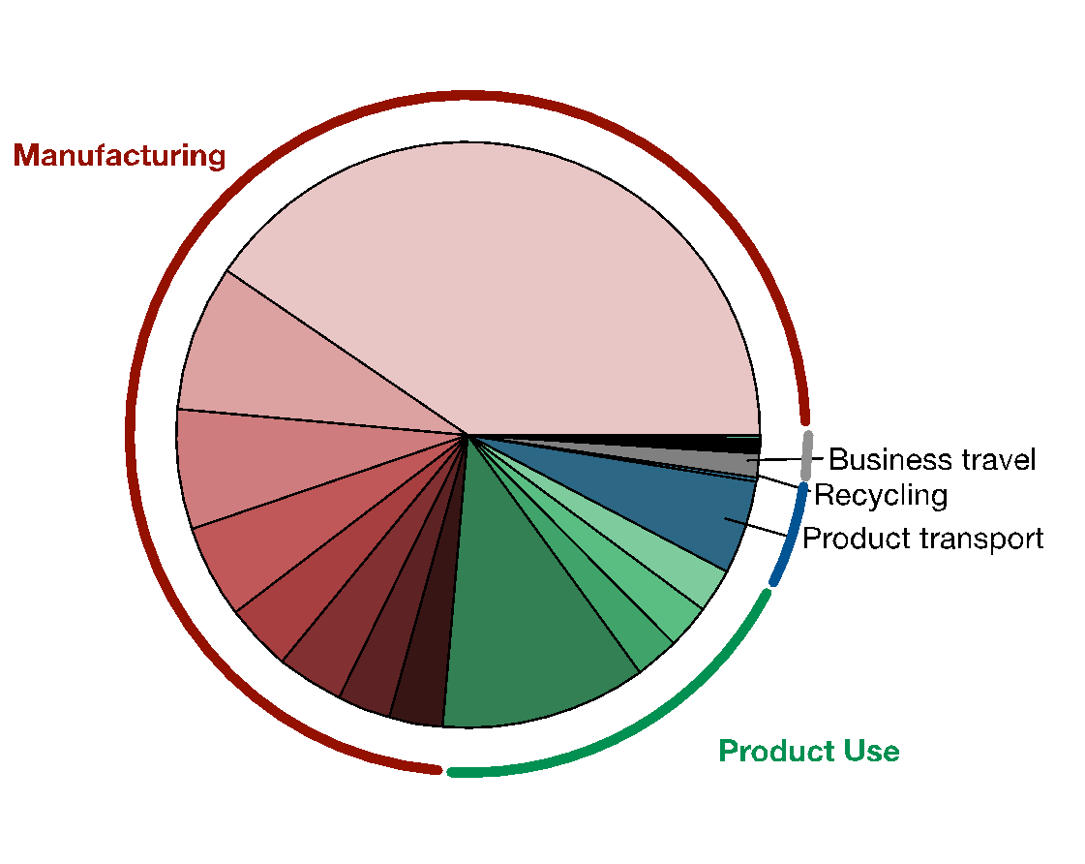
Manufacturing dominates Apple’s overall carbon footprint
Notes:
Here we look at the breakdown of Apple’s overall company-level footprint of 25 million metric tons of CO2 in 2019.
The hardware life cycle emissions are broken down into manufacturing shown in red, product use in green, transport in blue, and recycling in black.
In fact life cycle emissions account for nearly 98% of Apple’s footprint.

Slide 17
Manufacturing dominates Apple’s overall carbon footprint
Manufacturing accounts for 74% of Apple’s end to end breakdown in 2019
Notes:
As shown in red, Manfuacturing accounts for 74% of Apple’s end to end breakdown in 2019.

Slide 18
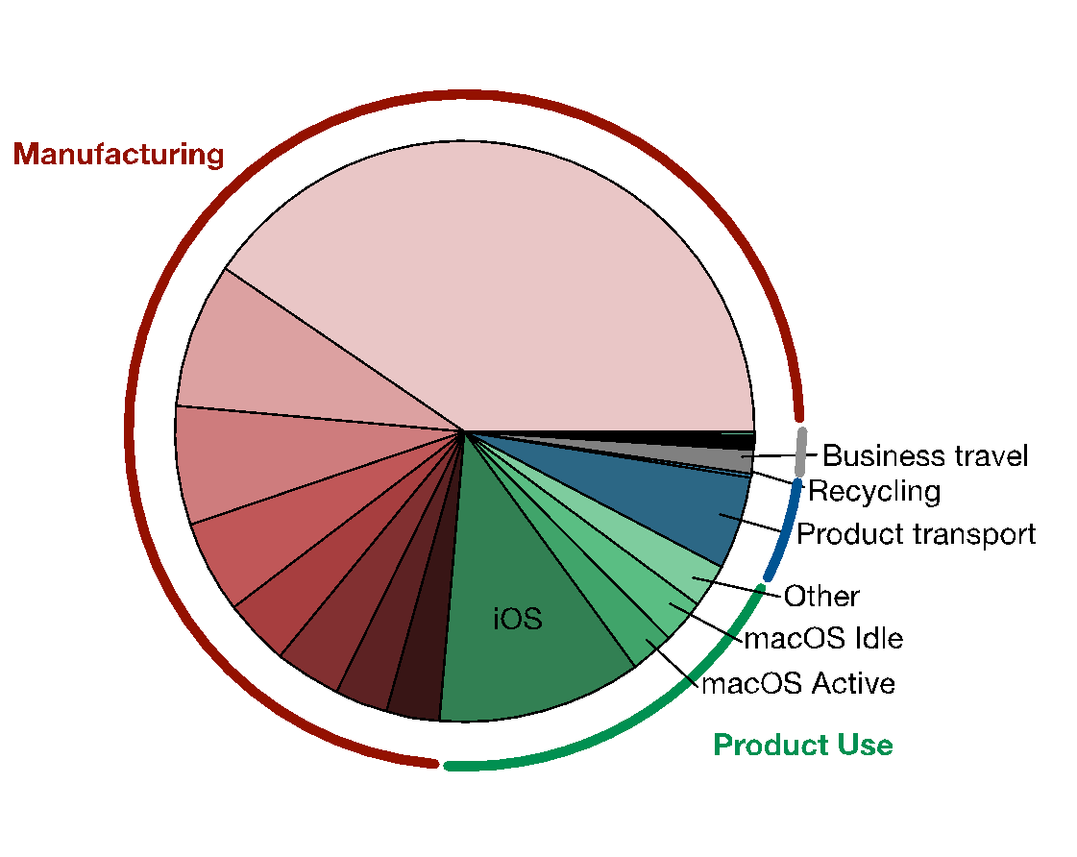
Manufacturing dominates Apple’s overall carbon footprint
Manufacturing accounts for 74% of Apple’s end to end breakdown in 2019
Notes:
Hardware use accounts for 19% of emissions.
Here, we find the majority of emissions are devoted to iOS devices like phones and tablets followed by macOS.
This includes emissions over the course of the entire life time of devices – typically 3 years for mobile phones.

Slide 19
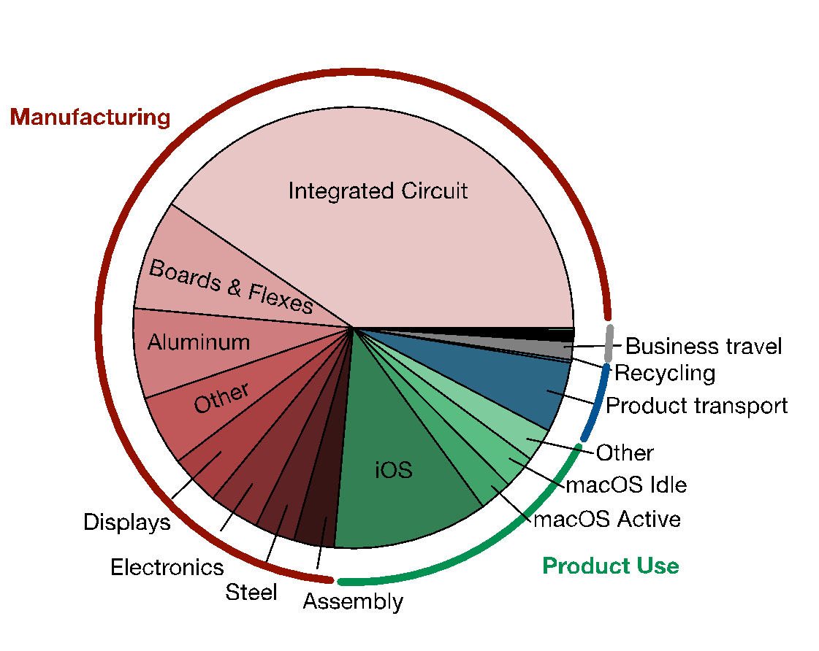
Manufacturing dominates Apple’s overall carbon footprint
Integrated circuits account for 33% of emissions (SoCs, DRAMs, NAND Flash)
Manufacturing accounts for 74% of Apple’s end to end breakdown in 2019
Notes:
Within the manufacturing emissions, we find integrated circuits account for 33% of emissions.
This is more than the emissions due to boards/flexes, aluminum, displays, and other electronics.
These emissions are largely due to SoCs, DRAMs, NAND Flash components in mobile devices --- directly related to hardware design and development.

Slide 20
Manufacturing dominates Apple’s overall carbon footprint
Integrated circuits account for 33% of emissions (SoCs, DRAMs, NAND Flash)
Manufacturing accounts for 74% of Apple’s end to end breakdown in 2019
Aggregating across hundreds of millions of phones, iPads, and other consumer devices sold every year!
“Chasing Carbon: The Elusive Environmental Footprint of Computing” Gupta et. al. (HPCA 2021) https://arxiv.org/abs/2011.02839
Notes:
Now, these emissions are aggregated across hundreds of millions of phones, iPADs, and other consumer devices sold each year.
Next, we study the emission breakdowns for individual hardware platforms.

Slide 21
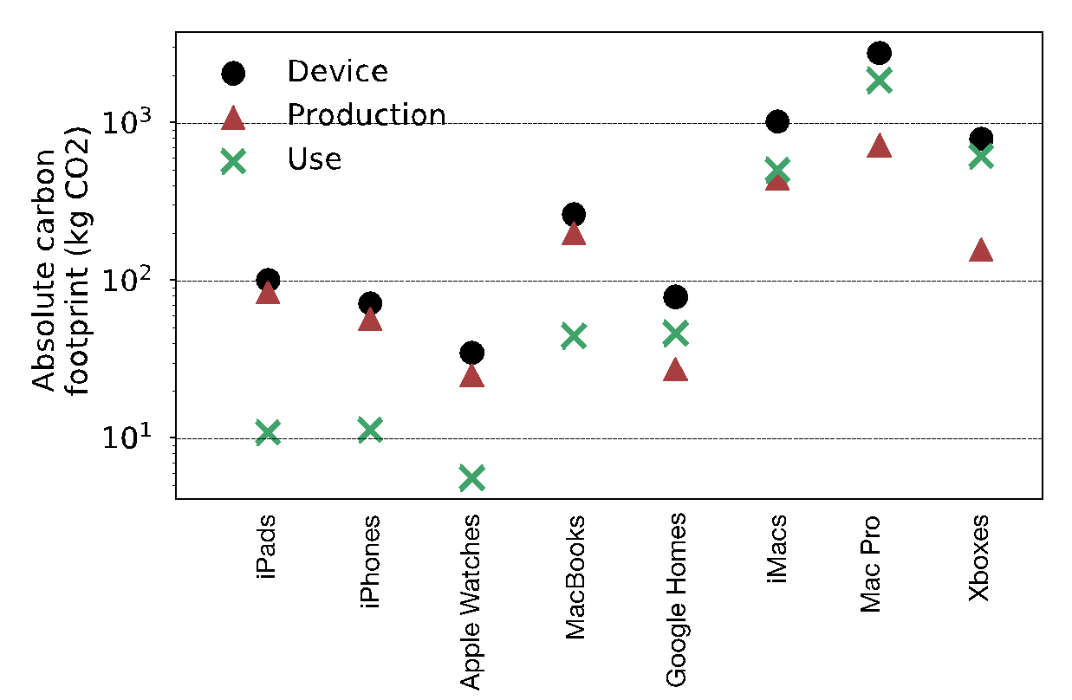
Carbon footprint characteristics vary across devices
Data from public industry validated sustainability reports and life cycle analyses
Battery operated
Plugged in
Notes:
So here we look at the carbon footprint breakdown of mobile devices.
On the x-axis we have 8 mobile devices. The first four are battery operated like iPads, iPhones, Apple Watches, and Laptops.
The last four are always connected or plugged in devices like personal assistants, desktops and gaming stations.
On the y-axis we have the absolute carbon footprint in log scale.
In black we see the end to end life cycle emissions, in red the manufacturing portion, and in green the emissions from hardware use and energy consumption.

Slide 22
Carbon footprint characteristics vary across devices
Data from public industry validated sustainability reports and life cycle analyses
Roughly 75% life cycle emissions for battery operated devices comes from hardware manufacturing.
Battery operated
Plugged in
Notes:
Across the battery operated devices we find that roughly 75% of emissions come from hardware manufacturing.

Slide 23
Carbon footprint characteristics vary across devices
Data from public industry validated sustainability reports and life cycle analyses
Roughly 75% life cycle emissions for battery operated devices comes from hardware manufacturing.
Emissions for always-connected devices come mainly from energy consumption
Battery operated
Plugged in
Notes:
On the other hand for plugged in devices we find the majority of emissions coming from energy consumption and roughly one third the footprint comes from hardware manufacturing.
We attribute the differences in carbon footprint breakdown across battery operated and always-connected devices to come from varying user behaviors such as frequency of use, different types of workloads, idle and sleep cycles, lifetime of hardware, and so on.
Another interesting point we see from this analysis is that the overall and manufacturing-related carbon footprints are not one-time, static costs.
Instead, they scale with hardware resources available in each platform.
In the paper you can find additional details about the carbon footprint breakdown across an even wider range of devices.
But for now, what I want to look at is another cross-section of this design space. Namely, how the carbon footprint of devices has been scaling over time.
### For example, the Mac Pro desktop without displays comprises the largest footprint given it comprises the largest hardware resources in terms of SoC capabilities, memory, and storage.

Slide 24
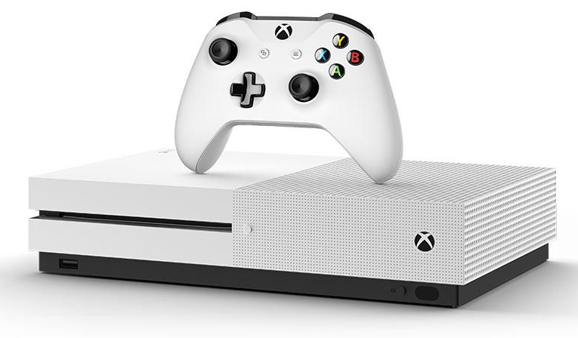
Carbon footprint characteristics vary across devices
Data from public industry validated sustainability reports and life cycle analyses
Roughly 75% life cycle emissions for battery operated devices comes from hardware manufacturing.
Emissions for always-connected devices come mainly from energy consumption
¹ Xbox Standby mode consumes 4 billion kWh
¹ “Latest Game Consoles: Environmental Winners or Losers?” National Resources Defense Council. Noah Horowitz
Battery operated
Plugged in
Notes:
On the other hand for plugged in devices we find the majority of emissions coming from energy consumption and roughly one third the footprint comes from hardware manufacturing.
We attribute the differences in carbon footprint breakdown across battery operated and always-connected devices to come from varying user behaviors such as frequency of use, different types of workloads, idle and sleep cycles, lifetime of hardware, and so on.
Another interesting point we see from this analysis is that the overall and manufacturing-related carbon footprints are not one-time, static costs.
Instead, they scale with hardware resources available in each platform.
In the paper you can find additional details about the carbon footprint breakdown across an even wider range of devices.
But for now, what I want to look at is another cross-section of this design space. Namely, how the carbon footprint of devices has been scaling over time.
### For example, the Mac Pro desktop without displays comprises the largest footprint given it comprises the largest hardware resources in terms of SoC capabilities, memory, and storage.

Slide 25
Today
Where does computing’s carbon footprint come from?
A combination of both energy consumed and hardware manufacturing (embodied carbon).
Application
Mobile
Data center
Understanding the breakdown of mobile emissions
Understanding the breakdown of data center emissions
Understanding the breakdown of semiconductor manufacturing
Fabs
Notes:
Finally, given our understanding of carbon emissions, we will conclude by charting paths for how to design future sustainable computing systems.

Slide 26

Greenhouse gas (GHG) Protocol
Technology company
Notes:
To study the breakdown of carbon emissions at the data center scale we use the green house gas protocol.
The GHG protocol is used by many companies including technology companies like Google, Facebook, Apple, Microsoft, and others.
The GHG protocol categories emissions into three main scopes.

Slide 27
Greenhouse gas (GHG) Protocol
Scope 1
Diesel, gas, refrigerant from facilities
Company-owned transport
Technology company
Notes:
First, Scope 1 quantifies emissions directly from burning diesel, gas, and refrigerants in facilities.

Slide 28
Greenhouse gas (GHG) Protocol
Scope 1
Diesel, gas, refrigerant from facilities
Company-owned transport
Scope 2
Purchased energy (renewables)
Technology company
Notes:
Scope 2 quantifies the emissions from purchased energy.
This includes the impact of buying renewable energy sources to offset the net or average carbon footprint from energy being consumed by data centers.
This net emission factor does not ensure that every unit of energy consumed by data centers comes from renewable energy but rather the average carbon intensity of energy consumed.

Slide 29
Greenhouse gas (GHG) Protocol
Scope 1
Diesel, gas, refrigerant from facilities
Company-owned transport
Scope 3 (Upstream)
Hardware and racks
Data center construction
Business travel
Scope 2
Purchased energy (renewables)
Technology company
Notes:
Finally, we have Scope 3 which comprises emissions from the supply chain.
Depending on the company, the supply chain can be separated into the upstream and down-stream supply chain.
The upstream primarily includes capital and purchased goods, business travel, and infrastructure setup.

Slide 30
Greenhouse gas (GHG) Protocol
Scope 1
Diesel, gas, refrigerant from facilities
Company-owned transport
Scope 3 (Upstream)
Hardware and racks
Data center construction
Business travel
Scope 3 (Downstream)
Use of sold goods
Transportation and distribution
Scope 2
Purchased energy (renewables)
Technology company
Notes:
On the other hand, the down stream supply chain and Scope 3 emissions comprise the use of sold goods and transportation and distribution of goods.
Note that in the context of data center oriented technology companies like Facebook and Google, Scope 3 emissions ar edominate dby the upstream footprint.

Slide 31
Greenhouse gas (GHG) Protocol
Scope 1
Diesel, gas, refrigerant from facilities
Company-owned transport
Scope 3 (Upstream)
Hardware and racks
Data center construction
Business travel
Scope 3 (Downstream)
Use of sold goods
Transportation and distribution
Scope 2
Purchased energy (renewables)
Technology company
Scope 2 emissions come from opex-related activities
Scope 1 and Scope 3 emissions come from capex-related activities
Notes:
Note that, in terms of data centers, Scope 2 emissions come from opex—related activities.
On the other hand, Scope 1 and Scope 3 emissions come from capex-related activites.

Slide 32
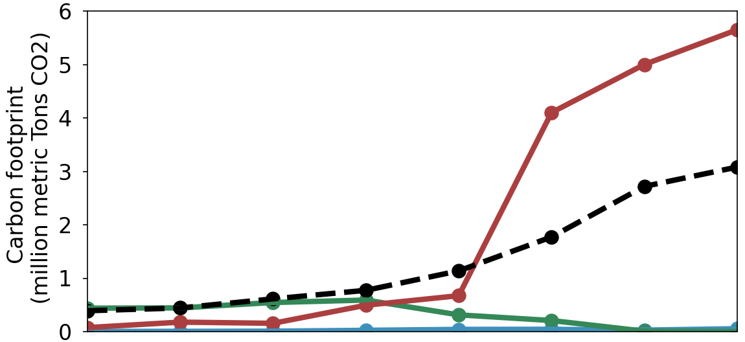
Historical analysis of Facebook’s carbon footprint
Scope 1 - Capex
Scope 2 - Opex
Scope 3 - Capex
Location-based Emissions
2014
2015
2016
2017
2018
2019
2020
2021
Notes:
Here we look at the historical trends in Facebook’s carbon footprint using the GHG protocol.
In blue we see net Scope 1 emissions.
In green, net Scope 2 emissions.
In red, net Scope 3 emissions.
On the x-axis we look at the breakdown between 2014 to 2019.

Slide 33
Historical analysis of Facebook’s carbon footprint
Scope 1 - Capex
Scope 2 - Opex
Scope 3 - Capex
Impact of renewable energy in data centers
2014
2015
2016
2017
2018
2019
2020
2021
Notes:
On the far right, we see the impact of Facebook purchasing renewable energy as the difference between the black dashed line and the green. We see Scope 2 emissions greatly reduce upon powering data centers with renewable energy.

Slide 34
Historical analysis of Facebook’s carbon footprint
Scope 1 - Capex
Scope 2 - Opex
Scope 3 - Capex
Scope 3 (capex) dominates Facebook’s carbon emissions.
49% of Scope 3 comes from hardware, infrastructure, data center construction
Impact of renewable energy in data centers
2014
2015
2016
2017
2018
2019
2020
2021
Notes:
Following the mobile analysis, we find that Scope 3 dominates Facebook’s carbon emissions.

Slide 35
Historical analysis of Facebook’s carbon footprint
Scope 1 - Capex
Scope 2 - Opex
Scope 3 - Capex
Scope 3 (capex) dominates Facebook’s carbon emissions.
49% of Scope 3 comes from hardware, infrastructure, data center construction
Change in HW footprint disclosure practice
Impact of renewable energy in data centers
2014
2015
2016
2017
2018
2019
2020
2021
Notes:
Interestingly we see a large increase in Facebook’s Scope 3 emissions between 2018 and 2019.
The increase is primarily due to a change in hardware footprint disclosure practices.
In particular prior to 2018, the carbon footprint related to emissions from manufacturing servers found in the data center were not included.
After 2018, hardware manufacturing emissions began to be included causing a stark rise in Scope 3 emissions.
The change disclosure practices highlight the need to motivate companies to report their carbon emissions over time.
In fact, we see similar trends across other data center oriented companies, like Google as outline din the paper below.

Slide 36
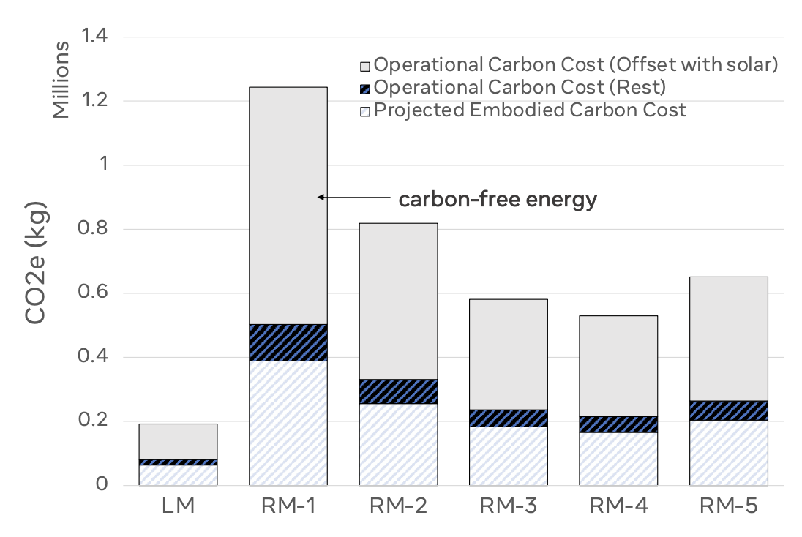
Crucial to look at emissions across HW cycle

Slide 37
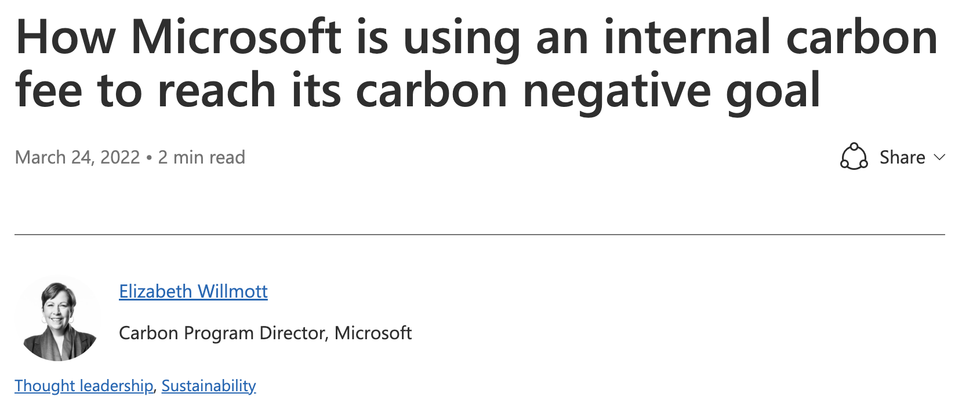
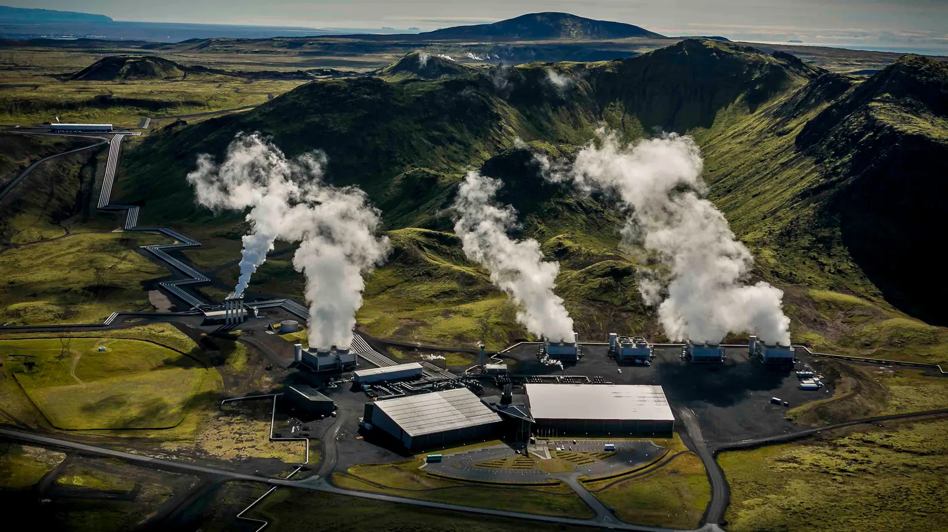
Economic incentives and carbon sequestration
Microsoft: $100/tCO2e to incentivize reductions
Projecting future annual cost of over $1 billion
Google: Estimates $50-$300/tCO2e as carbon sequestration scales up to 20% of the cost of a server!
https://cloudblogs.microsoft.com/industry-blog/sustainability/2022/03/24/how-microsoft-is-using-an-internal-carbon-fee-to-reach-its-carbon-negative-goal/
https://www.youtube.com/watch?v=W7uTbxCxmPg

Slide 38
Today
Where does computing’s carbon footprint come from?
A combination of both energy consumed and hardware manufacturing (embodied carbon).
Application
Mobile
Data center
Understanding the breakdown of mobile emissions
Understanding the breakdown of data center emissions
Understanding the breakdown of semiconductor manufacturing
Fabs
Notes:
Finally, given our understanding of carbon emissions, we will conclude by charting paths for how to design future sustainable computing systems.

Slide 39
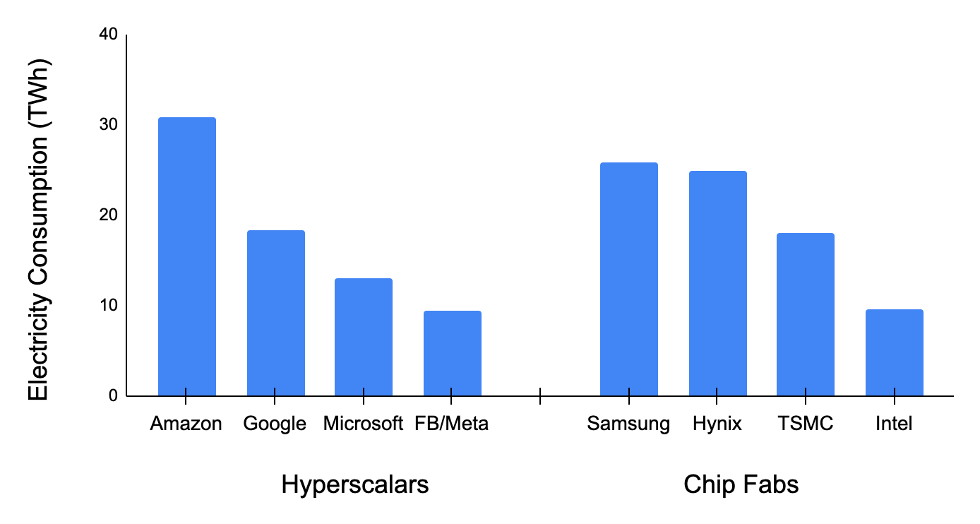
Chip manufacturing is energy intensive
Hyperscalar CAGR 25% since 2015
“Fab 4” CAGR 11% since 2015
USA Renewables CAGR 7% since 2015
Source: 2021 corporate sustainability reports

Slide 40

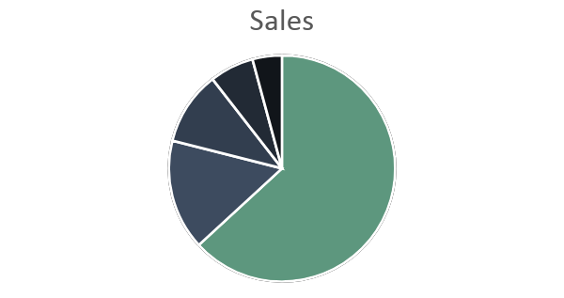
Semiconductor fab
Wafer & gas (10%)
PFCs (10%)
Energy
(60%)
Chemicals (15%)
Gupta et. al. Chasing Carbon: The Elusive Environmental Footprint of Computing (HPCA 2021)

Slide 41


Semiconductor fab
100% Renewable powered semiconductor fab
100% Renewable powered semiconductor fab
Wafer & gas (10%)
PFCs (10%)
Energy
(60%)
Chemicals (15%)
Reduces manufacturing footprint by 2.5x
Gupta et. al. Chasing Carbon: The Elusive Environmental Footprint of Computing (HPCA 2021)

Slide 42
“Green” powered fabs are not enough
Semiconductor fab
100% Renewable powered semiconductor fab
100% Renewable powered semiconductor fab
TSMC plans for
25% renewable by 2025 and 100% renewable by 2050.
Wafer & gas (10%)
PFCs (10%)
Energy
(60%)
Chemicals (15%)
Reduces manufacturing footprint by 2.5x
Gupta et. al. Chasing Carbon: The Elusive Environmental Footprint of Computing (HPCA 2021)

Slide 43
We must elevate carbon as a first order design target and constraint alongside
performance, power, energy, and area
Notes:
Finally, given our understanding of carbon emissions, we will conclude by charting paths for how to design future sustainable computing systems.

Slide 44
ACT Tutorial: Today
Time | Topic
1:00 – 1:15pm | Introductory remarks
1:15 – 1:30pm | Motivation: Understanding the source of computing’s emissions
1:30 – 2:15pm | Overview of ACT: An Architectural Carbon Modeling Tool
2:15 –2:30pm | Coffee Break
2:30 – 3:00pm | Hands-on ACT demo’s
3:00 – 3:15pm | Extending ACT
3:15 – 3:45pm | Office Hours
3:45 – 4:00pm | Closing remarks
Notes:
Finally, given our understanding of carbon emissions, we will conclude by charting paths for how to design future sustainable computing systems.

Slide 45
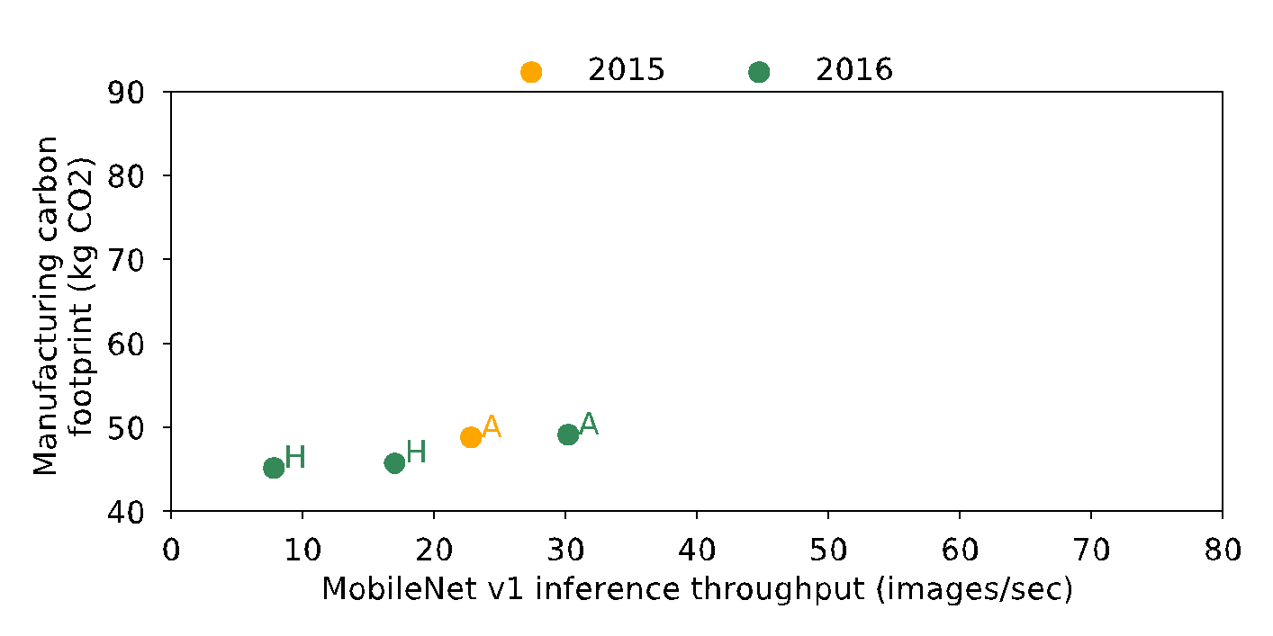
Performance versus manufacturing footprint
Data from industry (Apple, Google, Huawei) life cycle analyses and GeekBench performance measurements https://www.geekbench.com/blog/2019/09/geekbench-5/
Notes:
Here we study the tradeoff between performance and manufacturing related carbon emissions.
On the x-axis we have mobile Net v1 inference throughput gathered from Geekbench measurements.
On the y-axis we have manufacturing-related emissions gathered from publicly available sustainability reports from LCAs of devices with 128 GB capacity.
In yellow and green we have example mobile devices from 2015 and 2016.
H denotes devices from Huawei and A from apple.

Slide 46
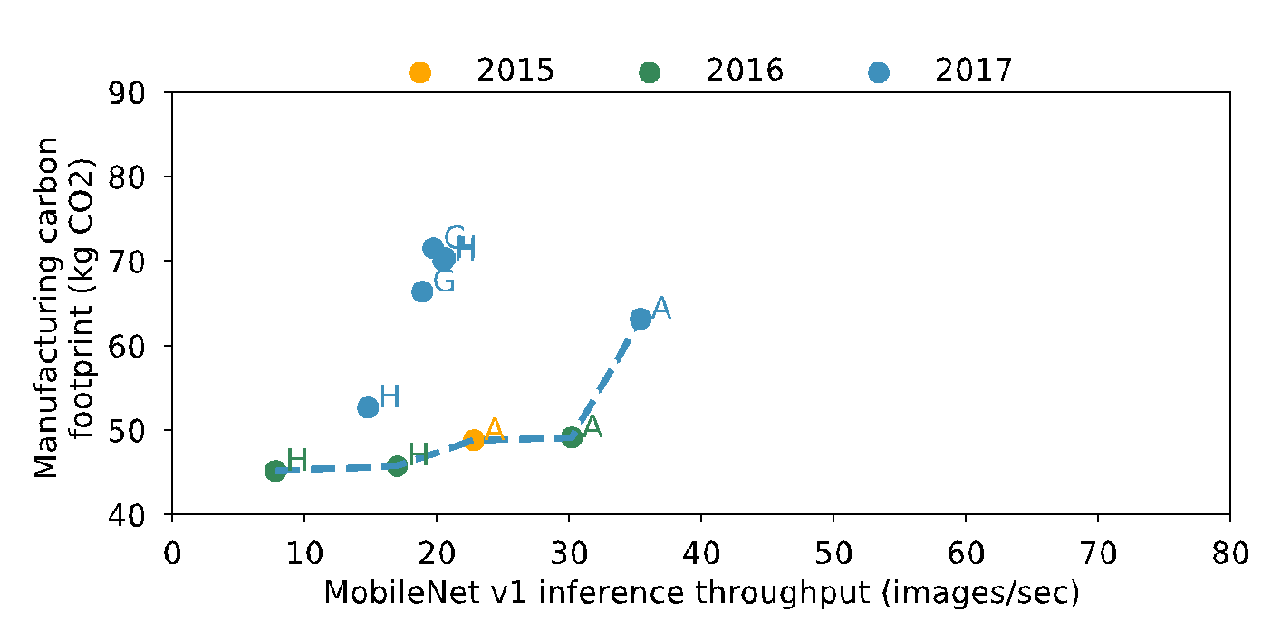
Performance versus manufacturing footprint
Data from industry (Apple, Google, Huawei) life cycle analyses and GeekBench performance measurements https://www.geekbench.com/blog/2019/09/geekbench-5/
Notes:
Adding 2017 in blue, we find a pareto curve forming between mobile performance and manufacturing related carbon emissions.

Slide 47
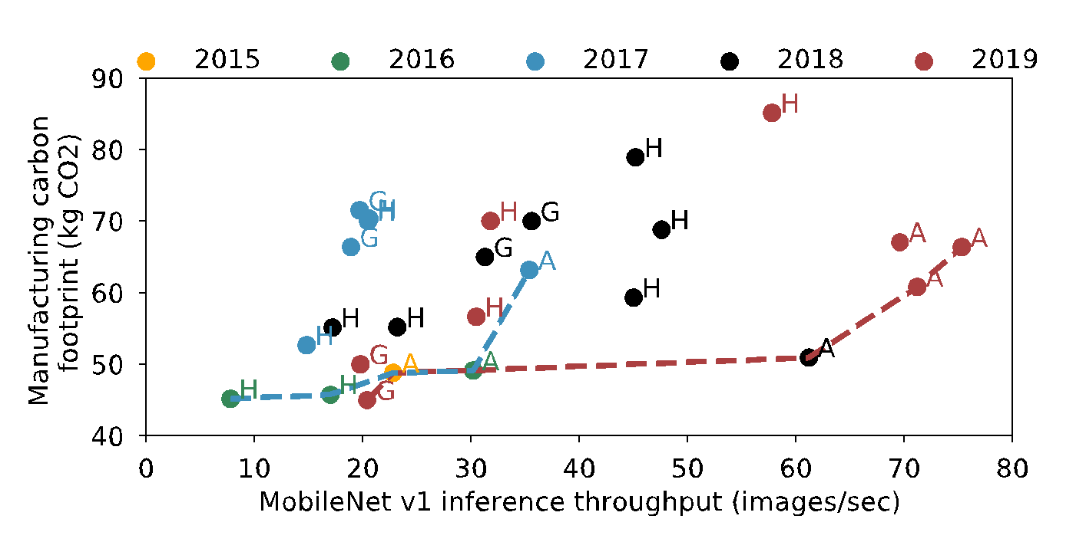
Performance versus manufacturing footprint
Data from industry (Apple, Google, Huawei) life cycle analyses and GeekBench performance measurements https://www.geekbench.com/blog/2019/09/geekbench-5/
Performance and efficiency improvement
Between 2017 and 2019 the Pareto frontier has shifted to the right prioritizing performance.
Designing sustainable systems requires shifting the frontier down.
Notes:
Further analyzing devices from 2018 in black and 2019 in red, we find that the Pareto-frontier from 2017 and 2019 shifted strictly to the right.
As a result, while performance has improved, carbon footprint has not.
These performance advantages are a result of both algorithm and hardware improvements.
Moving forward we need to think about ways to not only shift this Pareto to the right, but also downwards to lower emissions.
This includes carbon-aware resource provisioning and increasing the lifetime of hardware used.

Slide 48
Performance versus manufacturing footprint
Data from industry (Apple, Google, Huawei) life cycle analyses and GeekBench performance measurements https://www.geekbench.com/blog/2019/09/geekbench-5/
Performance and efficiency improvement
Between 2017 and 2019 the Pareto frontier has shifted to the right prioritizing performance.
Designing sustainable systems requires shifting the frontier down.
Notes:
In fact, in the paper we show that it takes over 3 years of continuously running AI inferences on a Pixel 3 phone for the carbon footprint from energy consumption to equal that of hardware manufacturing.
3 years is the average life time of our mobile phones!
This highlights the need to extend hardware lifetimes through increased reliability and future proofing hardware to provide sufficient performance on emerging applications.
More generally, lower footprint devices are crucial towards a sustainable computing future.

